Slide 1
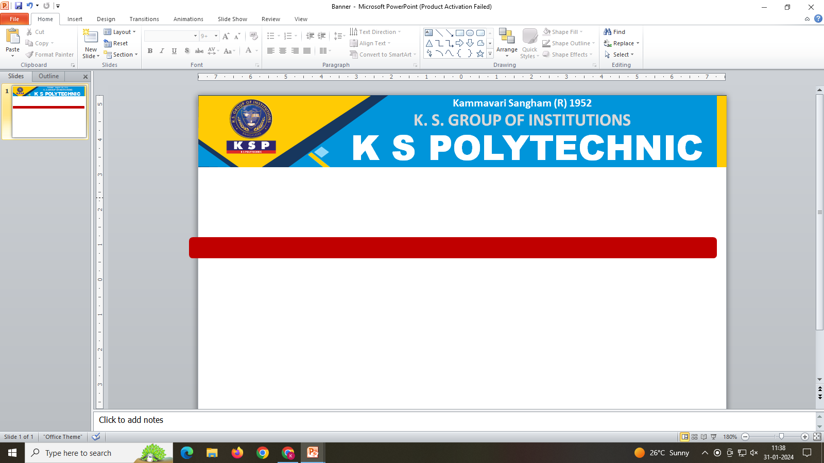
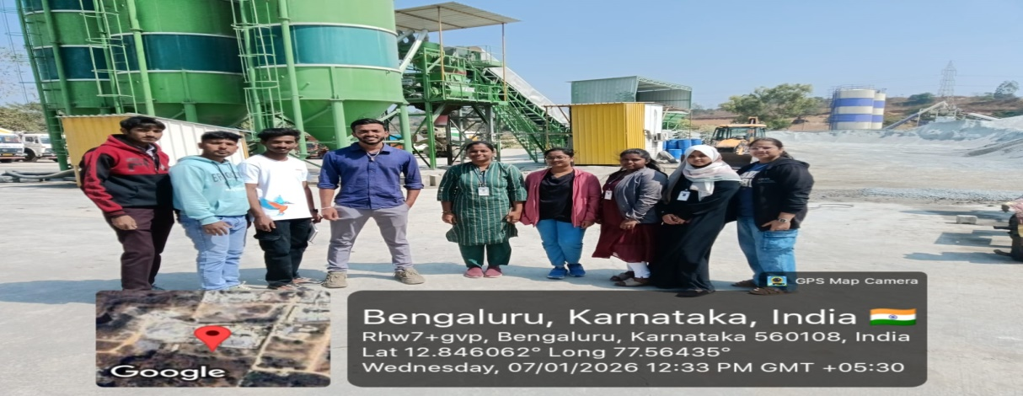
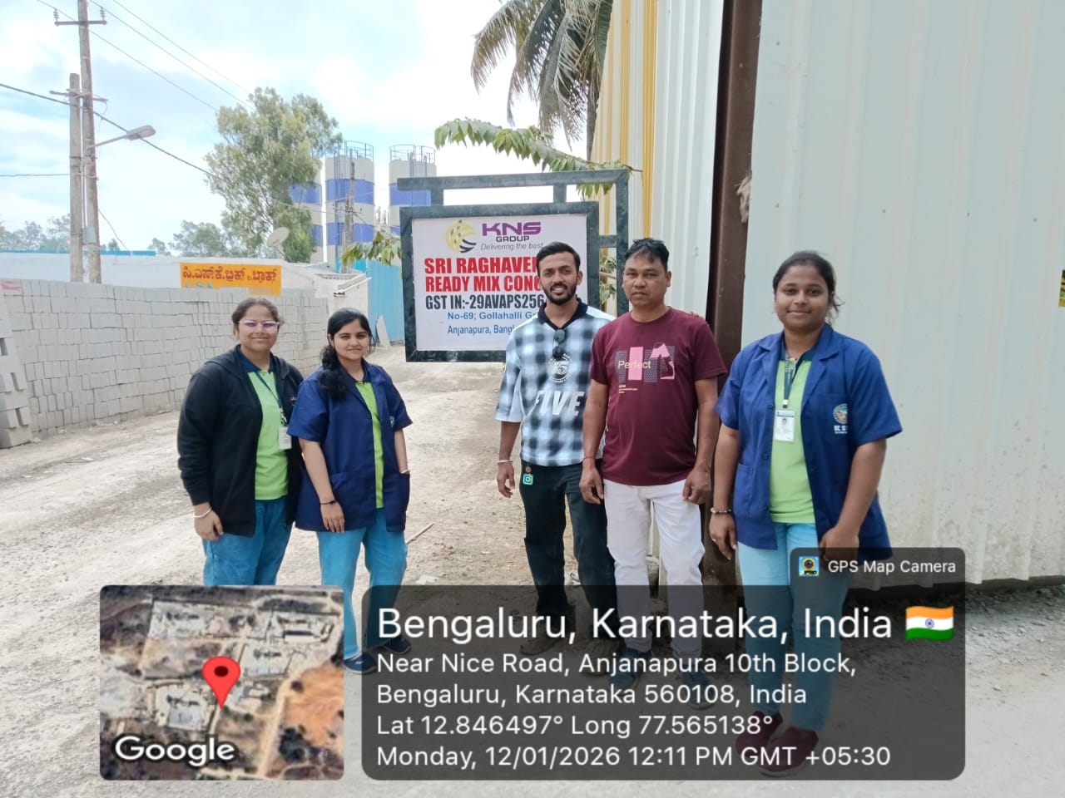
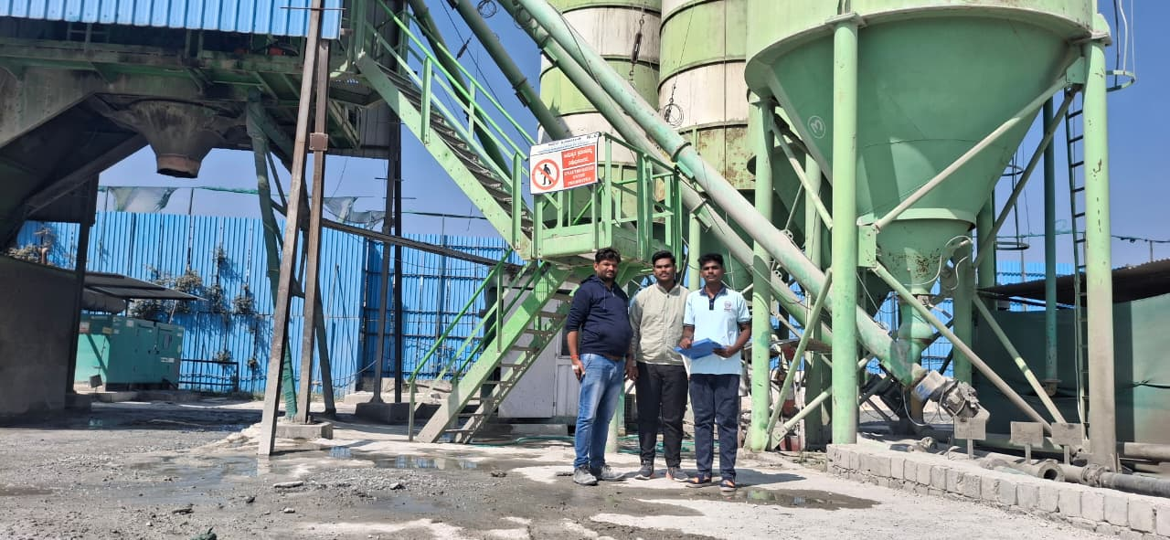
Department of Civil Engineering
The Management, Principal & Staff Congratulates all the 6th semester
students for securing internships.
Your achievement is commendable, and we wish you success in this valuable opportunity

