Slide 1
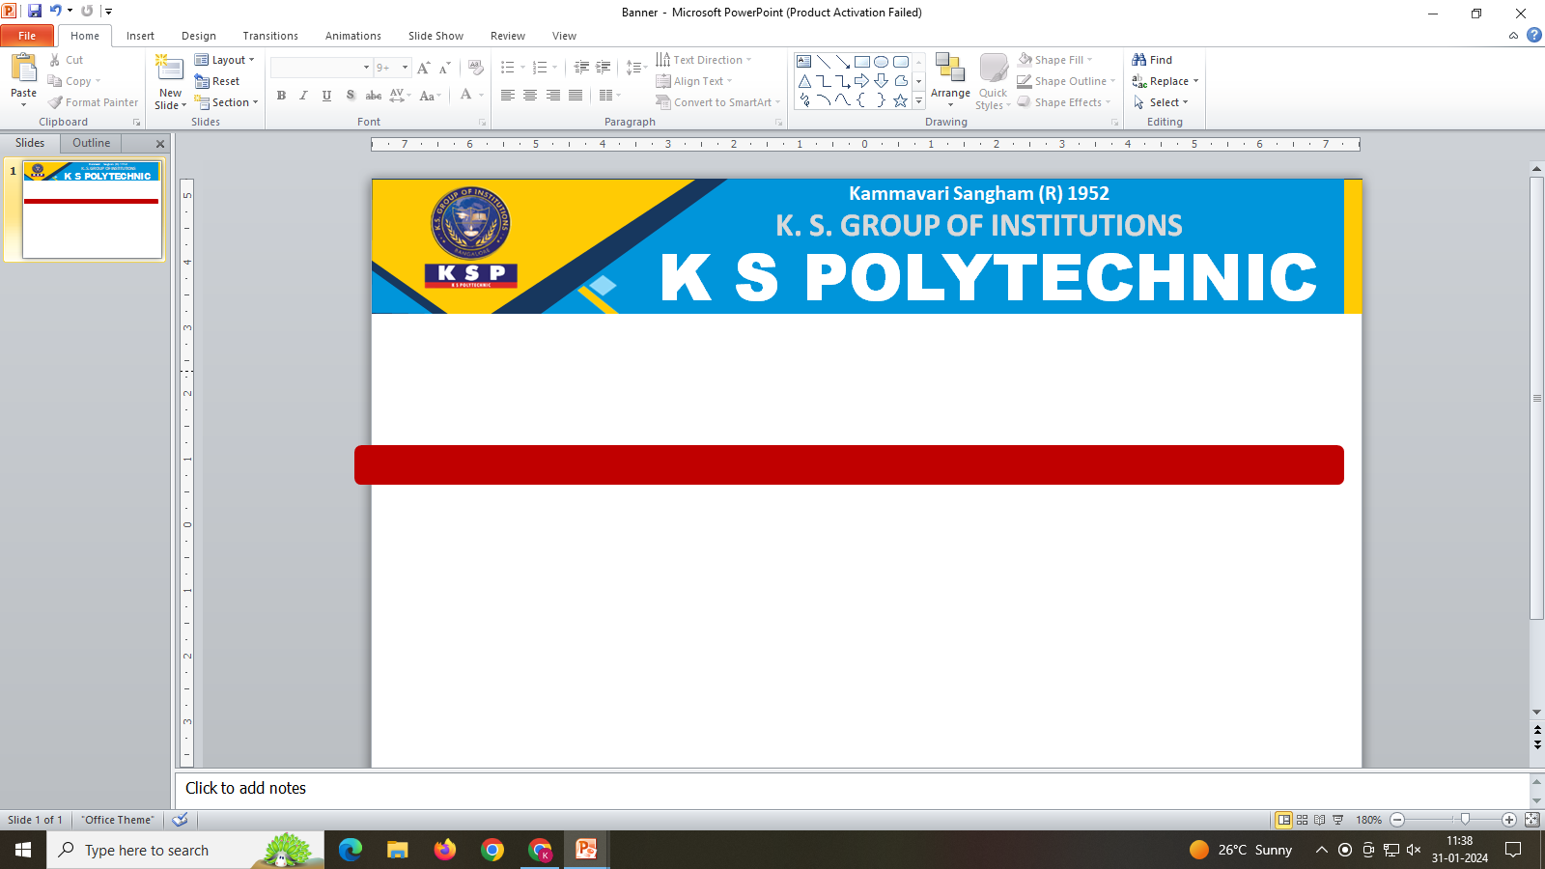
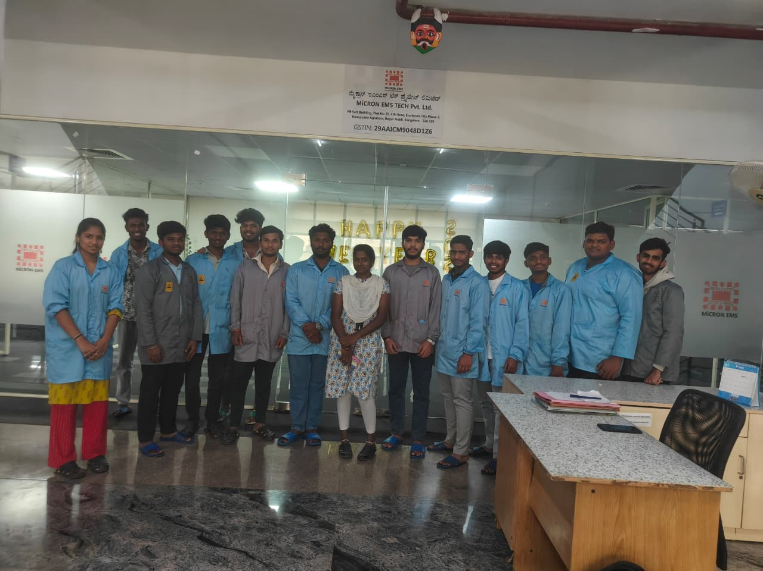
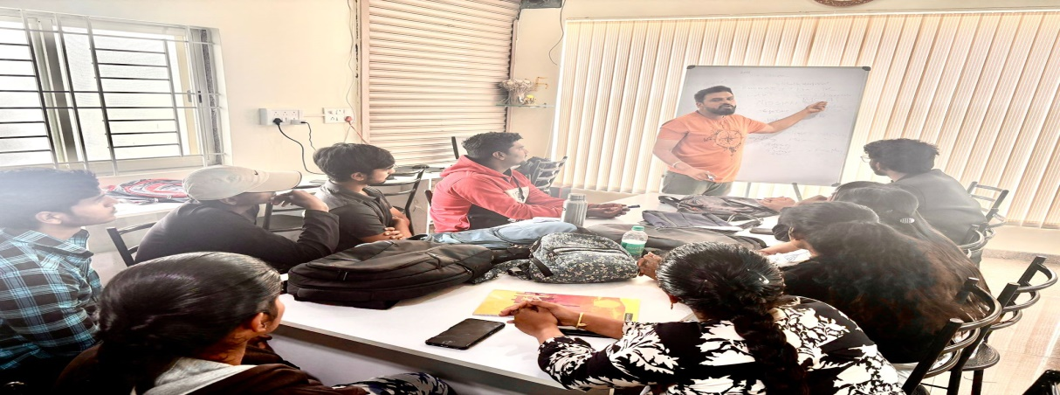

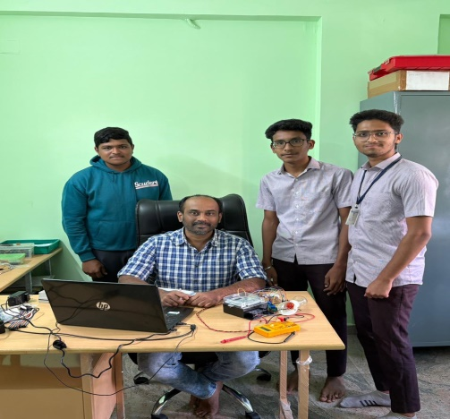
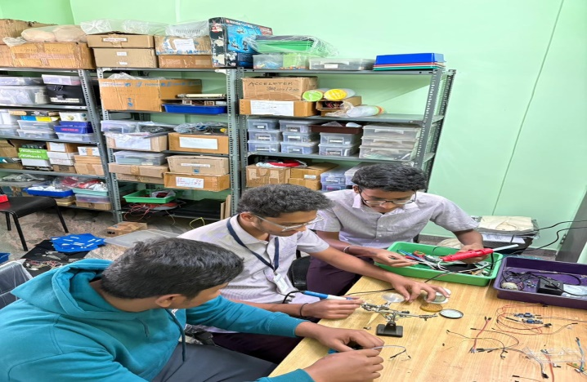
Department of Electronics & Communication Engg.
The Management, Principal & Staff Congratulates all the 6th semester
students for securing internships with industry - paid stipends.
Your achievement is commendable, and we wish you success in this valuable opportunity

